Slide 1
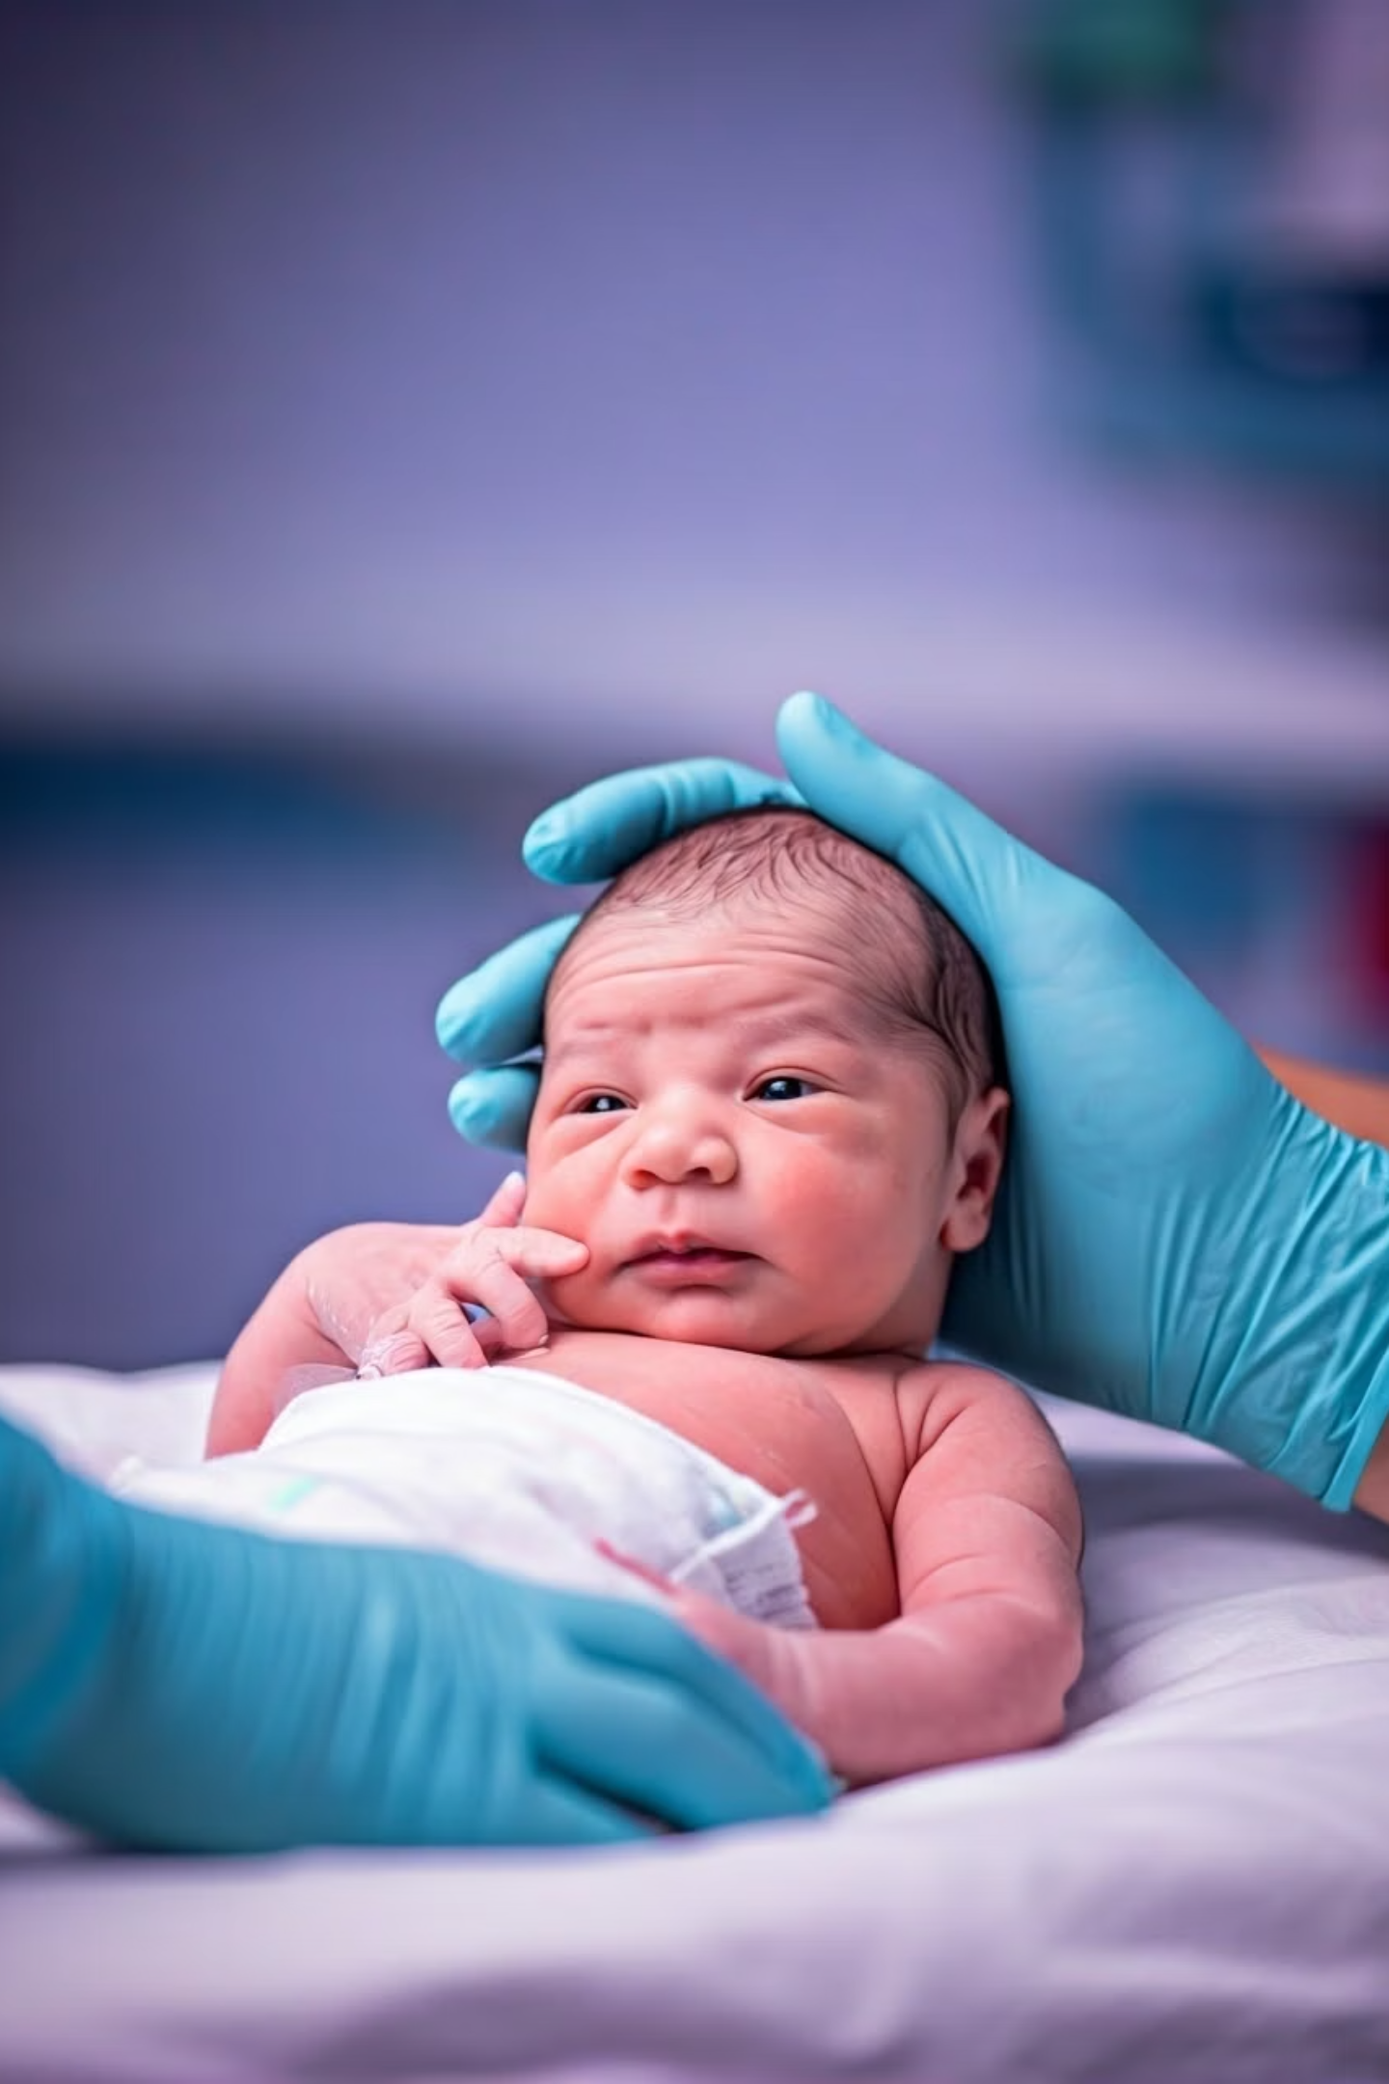
Enhancing Perinatal Care with AI-Driven Apgar Score Prediction
Yael kanter 315823245
Ofir ofek 312168347
1
Notes:
יעל

Slide 2

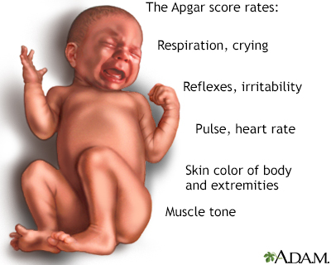



Understanding the Apgar Score
Vital Assessment
Evaluates five criteria: heart rate, respiratory effort, muscle tone, reflex response, skin color.
Clinical Importance
Low scores associated with increased neonatal mortality.
Timing
Measured at one and five minutes after birth.
Limitation
Currently a retrospective tool that cannot anticipate complications before delivery.
2
Notes:
יעל

Slide 3


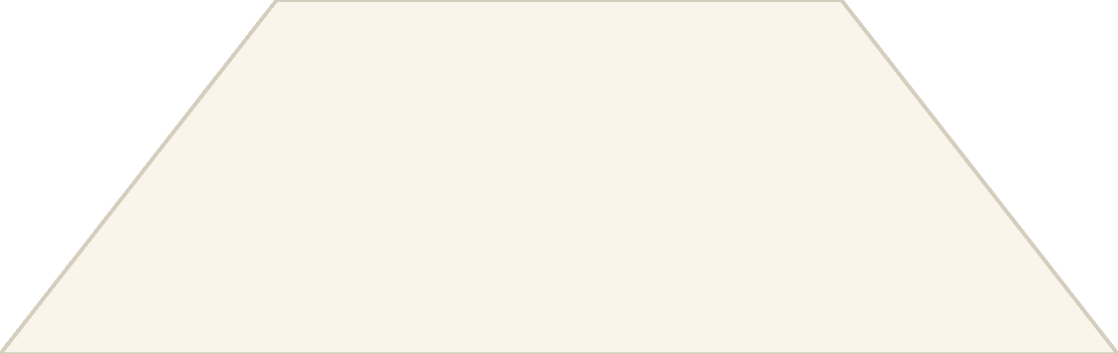

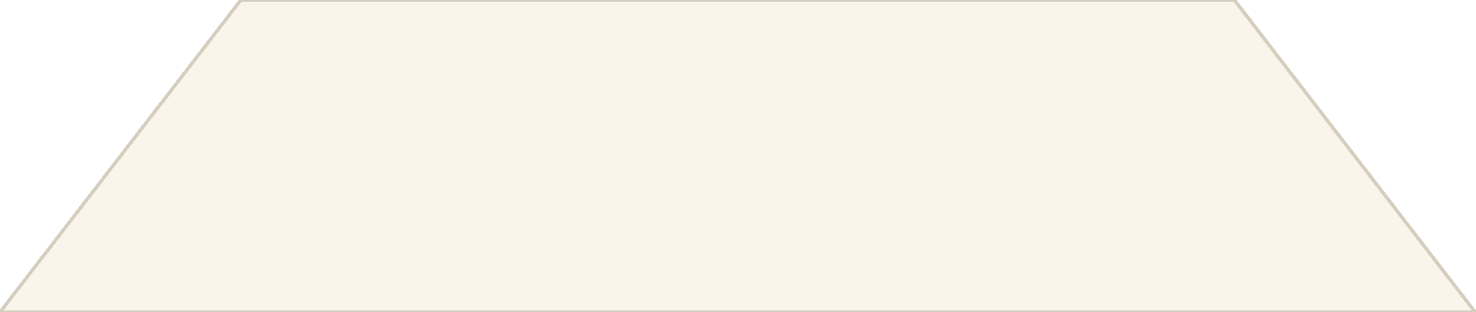

The AI Prediction Challenge
AI Solution
Predictive models that analyze complex perinatal data
Data Analysis
Finding patterns in maternal and fetal health indicators
Clinical Gap
Reliance on subjective judgment and basic monitoring
Healthcare professionals currently rely on clinical judgment and fetal monitoring, which often fall short in predicting outcomes. AI offers promising pathways to improve perinatal predictions by analyzing complex datasets.
3
Notes:
אופיר

Slide 4

Related Studies and Contributions
Apgar (1953)
Mdoe et al. (2022)
Rocha et al. (2022)
The Apgar score was created in 1953 by Dr. Virginia Apgar as a quick way to check a newborn's health. It’s still widely used today. Our project builds on this by using AI to predict the Apgar score before birth.
They looked at over 7,700 births in Tanzania and used machine learning to predict Apgar scores at five minutes. The most important factors were the mother's age, weeks of pregnancy, and the baby's weight. They used SMOTE to fix the class imbalance, which helped their model and gave us ideas for our own.
They reviewed AI models for predicting health outcomes in mothers and babies. They said models should be easy to understand and showed that common algorithms include logistic regression, SVMs, and random forests. This helped us choose models that are accurate and clear for doctors to use.
4
Notes:
אופיר

Slide 5
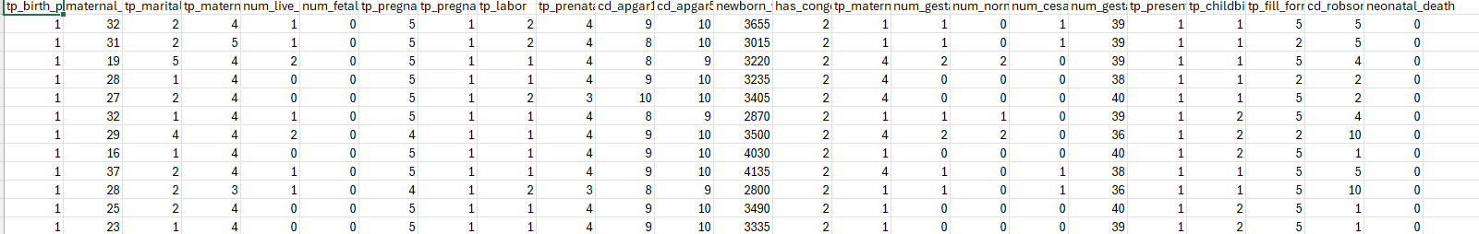
Data Collection and Preprocessing
• Dataset size:1,149,433 records (rows) and 24 features (columns)
• Feature types:
Continuous numerical features ( maternal_age, newborn_weight)
Categorical nominal features (tp_pregnancy, tp_labor, tp_birth_place)
Ordinal categorical features (cd_apgar1, cd_apgar5, tp_pregnancy_duration)
Binary target variable: neonatal_death (0 = survivor, 1 = death)
• Class imbalance -The dataset is very unbalanced, with only a few babies who died after birth and had low Apgar 1 and 5 scores. To help the model learn from these rare but important cases, we used SMOTE to create extra examples during training. This helps the model better recognize when a newborn is at risk.
5
Notes:
יעל

Slide 6




Data Cleaning Strategy
Remove Incomplete Records
Used dropna() to select only rows with complete numerical data.
Eliminate Outliers
Applied Isolation Forest algorithm to detect and remove statistical anomalies.
Replace Missing Values
Substituted remaining undefined values with placeholders like -1.
6
Notes:
יעל
df.isnull().sum()
df.fillna(-1, inplace=True)
Isolation Forest helps detect data points that are very different from the rest. These outliers can confuse the model or reduce accuracy. By removing them, we make sure the model learns from more realistic, typical cases.
For other missing values (especially categorical or mixed), instead of deleting them, we filled them in with a placeholder like -1.

Slide 7

SMOTE: Balancing Rare Medical Cases
What is SMOTE? SMOTE (Synthetic Minority Over-sampling Technique) helps balance datasets by creating new, synthetic examples of rare cases, so that machine learning models can better learn to detect them.
Identify Minority Class
Find all rare cases ( low Apgar scores)
Find Nearest Neighbors
For each minority point, identify k nearest neighbors from the same class.
Generate Synthetic Samples
Create new examples along the line between points using random interpolation.
7
Notes:
אופיר

Slide 8

Dangers with SMOTE with Clinical Data
Generating unrealistic samples
Exacerbating noise
SMOTE can create synthetic clinical records that do not represent plausible patient data or biological reality, leading to models learning from non-existent conditions.
If the minority class is noisy, SMOTE will propagate and amplify this noise, resulting in a less robust model.
Overfitting to synthetic data
Loss of interpretability
Models trained on SMOTE-generated data may overfit, performing well on balanced training sets but failing to generalize to real-world, imbalanced clinical data.
Synthetic data can obscure true relationships, making it harder to interpret model findings and identify genuine risk factors.
Ethical considerations
Misrepresentation of patient conditions by synthetic data raises ethical concerns regarding patient safety and treatment.
8
Notes:
אופיר

Slide 9



Model Selection: Choosing the Right AI for Apgar Score Prediction
Fits Medical Needs
Our main goal is to predict Apgar 1 and 5 scores before the baby is born.
This helps us find babies who might be at risk early. The model should avoid missing these cases, because not warning in time could delay life-saving treatment.
Matched to Our Dataset
Our dataset has many different real-world features, like mother’s age, weeks of pregnancy, delivery type, and birth defects.
10
Notes:
יעל

Slide 10


Model Selection: Choosing the Right AI for Apgar Score Prediction
Clinically-Oriented Metrics
Recall (sensitivity) is prioritized: catching at-risk babies matters more than over-alerting.
Precision is also considered: minimizing false alarms helps ensure trust in clinical use.
Explainability Matters
In medicine, a prediction is only helpful if people can understand it. We chose models that are easy to explain, such as:
Tree-based models help us see which features are most important for the prediction. This makes the results easier to understand and explain
SHAP helps us see how much each factor contributed to the prediction, so doctors can understand why
the model made its decision.
11
Tree-based models for feature attribution
SHAP values explain the "why" behind predictions
Notes:
יעל

Slide 11

Model Selection
Logistic Regression
Random Forest
Advantage: Robust, handles data variability well, Works well with small datasets.
Disadvantages: Limited complexity, assumes linearity.
Advantage: Captures non-linear patterns, Handles large feature sets well
Disadvantages: Less interpretable, can overfit without tuning, Slower with very large data.
Handles mixed data and missing values well
Handles mixed data and missing values well
Shows feature importance for key risk factors
Shows feature importance for key risk factors
Reduced risk of overfitting
Lower overfitting risk
12
Notes:
אופיר

Slide 12
XGBoost
Neural Networks
Advantage: High performance on structured, imbalanced data
Disadvantages: Complex tuning, less transparent.
Advantage: Learns complex relationships
Disadvantages: Needs more data, have many layers and steps inside.
Can learn how different factors work together, like mother’s age and type of labor affecting risk.
Balances precision and recall well, even after SMOTE.
Good at finding complex patterns in the data in a fast and simple way
Can get high recall to help catch more at-risk cases
13
Notes:
יעל
A tree-based boosting model that combines many small trees to make strong predictions.
Because they use many layers and connections that transform the data in complex ways. It’s hard to see exactly how each input leads to the final prediction.

Slide 13
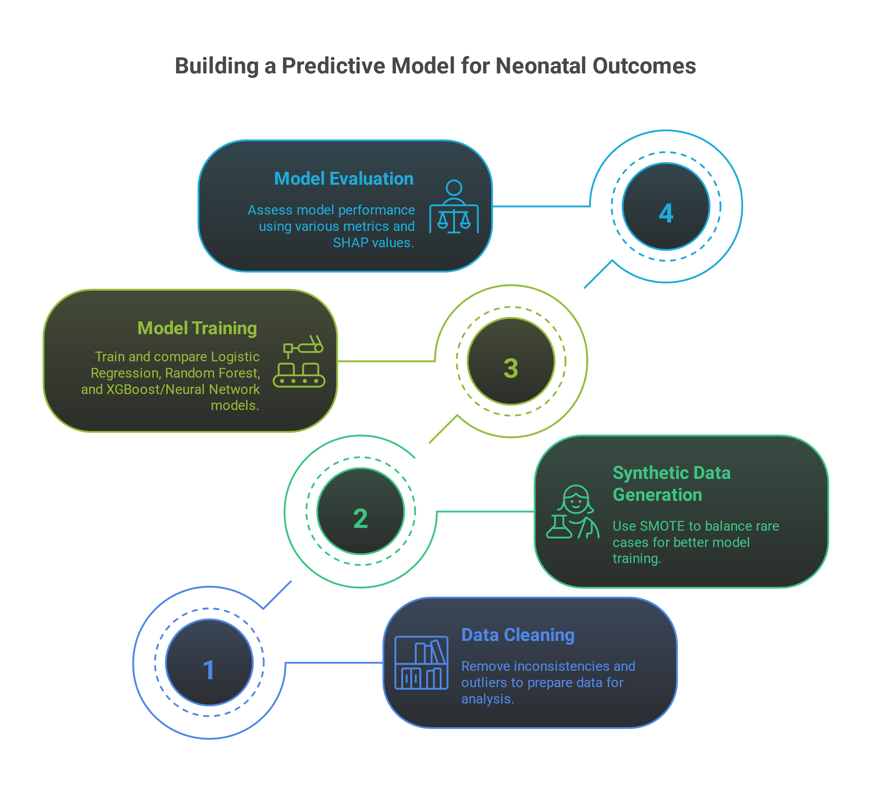
14
Notes:
אופיר

Slide 14

Evaluation Metrics
—
—
AUC)Area Under the Curve( Target
F1 Score Goal
Area Under Curve threshold for successful model performance.
Balance between precision and recall for clinical usefulness.
—
K-Fold Validation
Cross-validation folds to ensure consistent performance.
15
Notes:
מה זה: מדד שמראה כמה טוב המודל מצליח להפריד בין המקרים החיוביים והשליליים (למשל – תמותה או לא). מה להגיד:
We looked at the AUC-ROC to measure how well the model distinguishes between healthy and at-risk newborns. A higher AUC means better classification performance overall.
F1 Score Goal
מה זה: ממוצע בין Precision (כמה התחזיות החיוביות נכונות) ו-Recall (כמה מהמקרים האמיתיים החיוביים נתפסו). מה להגיד:
The F1 score helped us balance between catching all risky cases (recall) and avoiding false alarms (precision), which is especially important in medical settings.
מה זה: שיטה של חלוקת הדאטה ל־k קבוצות כדי לבדוק שהמודל יציב ואחיד ולא תלוי בחלוקה ספציפית. מה להגיד:
We used k-fold cross-validation to make sure our results weren’t based on just one lucky or unlucky train-test split. It gave us more reliable and stable results.
יעל ואופיר

Slide 15





End-Goal Product:
machine learning model provides, quick insights about the baby’s expected condition based on patient data
Data Input
Doctors enter mother and baby health information
AI Processing
Model analyzes data patterns to generate predictions.
Risk Assessment
Predicts Apgar score and explains key factors for doctors
Clinical Decision
Doctors get ready to give the best care to the babies
16
Notes:
יעל

Slide 16




Future Directions
Expanded Datasets
Real-Time Integration
Include data from more hospitals and countries to improve generalizability.
Connect directly to hospital systems for instant predictions during labor.
Clinical Trials
Test the model in real hospitals to evaluate actual impact on outcomes.
17
Notes:
יעל ואופיר ונסכם
This slide shows our future plans. First, we want more data from many hospitals and countries. This will help the model work better everywhere. Second, we want to predict specific risks, not just low Apgar scores.
For example, instead of just predicting a low Apgar score, we want to identify specific risks like premature birth, lack of oxygen, infections, or birth defects.
We also want real-time use in hospitals, giving instant predictions during labor. Finally, we plan clinical trials to test the model in real hospitals and see the real impact.

Slide 17

Thank you for listening

